Slide 1
NeuroSIM V1.4 Summary of WAGE-Quantization
by Elija Vida

Slide 2
WAGE-Quantization
→ neurosim developers have used the following github repo for applying WAGE quantization: https://github.com/stevenygd/WAGE.pytorch/
→ in ./models directory, we find the files „wage_quantizer.py“ and „wage_initializer.py“ which are very similar (with some modifications though) to the equally named files in NeuroSIM

Slide 3
WAGE-Quantization
WAGE: method for discretizing both training and inference, where weights (W), activations (A), gradients (G), and errors (E) among layers are shifted and linearly constrained to low-bitwidth integers.
To perform pure discrete dataflow for fixed-point devices, they further replace batch normalization by a constant scaling layer and simplify other components that are arduous for integer implementation.
→ WAGE acts as a regularizer

Slide 4
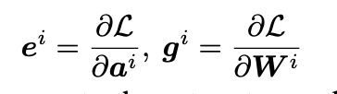
WAGE-Quantization
For operands, linear mapping and orientation-preserved shifting are applied to achieve ternary weights, 8-bit integers for activations and gradient accumulation
For operations, bacth normalization is replaced by a constant scaling factor, SGD optimizer with momentum or L2 regularization are abandoned or simplified with little performance degredation
Main idea: constrain 4 operands to low-bitwidth integers: weight and activation in inference, error (=gradient of activation for the perspective of each convolution or fc-layer) and gradient in backpropagation training.

Slide 5
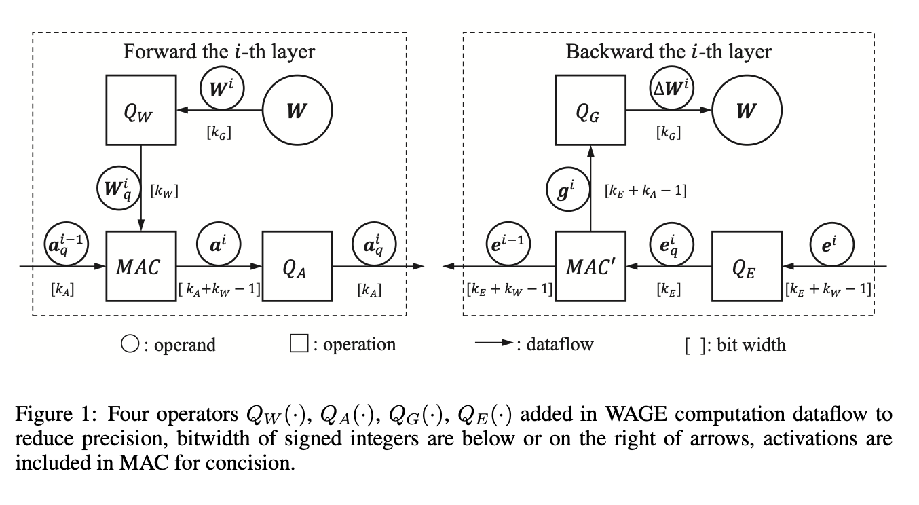


WAGE-Quantization
Forward propagation:
Weights: Q_W maps higher precision weights to their k_W-bit reflections
Activations: Q_A quantizes activations to k_A bits to align the increased bitwidth caused by MACs
→ when discretizing even to binary values, it becomes extremely efficient!

Slide 6
WAGE-Quantization
Backward propagation:
Additional functions Q_E and Q_G constrain bitwidth of e (error) and g (gradient) to K_E and K_G bits

Slide 7



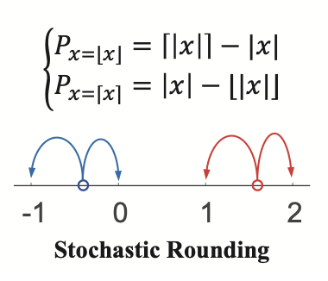
WAGE-Quantization
General Quantization Strategy in WAGE:
Linear, symmetric mapping with uniform distance for simplicity
round(): approximates continuous values to nearest discrete states
Clip(): saturation function, clips unbounded values to [1+sigma, 1-sigma]
Before this, esp. in error e, additional monolithic scaling is applied to shift value distribution to an appropriate order of magnitude, to avoid saturation or clipping of values using Q(x,k)
Lastly, stochastic rounding is applied to substitute real-values updates for gradient accumulation in training

Slide 8
WAGE-Quantization
Weight initialization:
Weights are cautiously initialized, batch normalization is simplified to constant scaling layer
Modified initialization method based on MSRA (He et al, 2015):
Where:
n_in is layer fan-in
L_min is a minimum value that the uniform distribution U should reach to ensure weights go beyond sigma and are quantized to non-zero values after Q_W when initialized randomly
Beta: constant >1 to create overlaps between min step-size sigma and max value L

Slide 9



WAGE-Quantization
Quantization Details:
Weight Q_W:
Direct application of previous equation:
To avoid explosion of network‘s outputs, a layer-wise shift-based scaling is applied:
Where alpha is pre-defined constant for each layer determined by network structure
Alpha takes effect after activations to maintain precision of weights
Activation Q_A:
Should counteract bitwidth increase after MAC operations

Slide 10

WAGE Quantization
Error Q_E:
Problem: errors are unbounded as compared to activations
But it‘s orientation rather than orders of magnitude that guide previous layers to converge → orientation-only preservation allows for error-propagation using integers only
Here: scale error distribution to [-sqrt(2), +sqrt(2)] by divinding with a Shift()-factor and then using Q(e, k_E):

Slide 11

WAGE Quantization
Gradient Q_G:
We rescale gradients g using Shift(), then apply shift-based learning rate eta (eta=integer of power 2):
To substitute accumulation of small gradients at later stages of training, g_s is separated into int + float part, then use 16-bit random number generator to constrain high bitwidth g_s to k_G-bit int stochastically:
Weights might exceed range [1+sigma, 1-sigma], so clipping is required. At t-th iteration, we have

Slide 12
WAGE Quantization
Miscellaneous:
1. For memory efficiency, WAGE only uses pure mini.batch SGD optimizers without any form of momentum or adaptive learning rate
2. L2 weight decay and dropout are allowed with WAGE quantization
Because softmax and cross-entropy use exp() which is hard to implement in low-bandwidth use cases, they are avoided in WAGE and SSE (sum-square-error) is preferred

Slide 13
WAGE Quantization & NeuroSIM
As the code in NeuroSIM differs to the github repo of WAGE creators, they have probably adapted some strategies that differ from original paper
Future work in WAGE paper:
non-linear quantization assumption in the paper was just used for simplicity, could have been changed in neurosim
Normalization: is necessary in real-world applications, should be included in future work according to authors, could have been fixed by NeuroSIM use-case

